Slide 1
From North and South
to the Beautiful Land
Lesson 12

Slide 2
The Relationship of Daniel 11 to Daniel 8 and 9
Daniel 11 | Daniel 8, 9
11:2 The kingdom of Persia | 8:20 The ram of Persia
11:2 The kingdom of Greece | 8:21 The goat of Greece
11:3 A might king appears in Greece | 8:21 The large horn as the first king of Greece = Alexander the Great
11:4 The four winds = the scattering of the empire of the great king | 8:22 The four kingdom that rise out of the large horn of Greece
11:16 The Beautiful Land is conquered | 8:9 Pagan Rome conquers the Beautiful Land of Israel
11:22 Prince of the covenant will be destroyed | 9:25 Pagan Rome cuts off the Anointed One at Calvary

Slide 3
⁸ Therefore the male goat grew very great; but when he became strong, the large horn was broken, and in place of it four notable ones came up toward the four winds of heaven. ²¹ And the male goat is the kingdom of Greece. The large horn that is between its eyes is the first king. ²² As for the broken horn and the four that stood up in its place, four kingdoms shall arise out of that nation, but not with its power. Daniel 8:8, 21-22 | ² And now I will tell you the truth: Behold, three more kings will arise in Persia, and the fourth shall be far richer than them all; by his strength, through his riches, he shall stir up all against the realm of Greece. ³ Then a mighty king shall arise, who shall rule with great dominion, and do according to his will. ⁴ And when he has arisen, his kingdom shall be broken up and divided toward the four winds of heaven, but not among his posterity nor according to his dominion with which he ruled; for his kingdom shall be uprooted, even for others besides these. Daniel 11:2-4

Slide 4
Cyrus
1. Cambyses
2. False Smerdis
3. Darius I Hystaspes
4. Xerxes Ahasuerus

Slide 5
Xerxes Alexander the Great

Slide 6
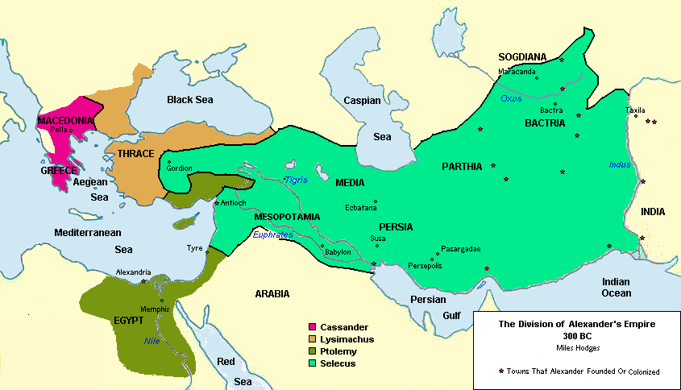

Slide 7
Daniel 11 | King of the south - 305 – 30 BC | King of the north - 305 – 63 BC | Highlights
Vs 5 | Ptolemy I Soter | Seleucus I Nicator
Vs 6 | Ptolemy II Philadelphus | Antiochus II Theos | Alliance by marriage (Berenice to Antiochus). Ptolomy dies, Laodice (Ex-wife of Antiochus) kills Antiochus, Bernice and Bernice’s son
Vs 7 - 8b | Ptolemy III Euergetes | (Antiochus II dead) | Evenges Bernice, captures Syrian capital, later gives up but comes back with booty and some of their gods
Vs 9 | Ptolemy III Euergetes | Seleucus II | Seleucus attacks in retaliation, but is not successful
Vs 10 - 13 | Ptolemy IV Philopater | Seleucus III Ceraunus (226 – 223 B.C. | Short lived
Vs 10 - 13 | Ptolemy IV Philopater | Antiochus III Magnus (223-187 B.C.) | Battle of Raphia (defeated by Ptolemy IV Philopater); went back east to win back Seleucid kingdom (successful); turns back to Egypt and is more successful than the first time
14 - 15 | Ptolemy V | Antiochus IV Epiphanes (175 B.C. – 163 B.C.) | 14 refers to those that opposed the king of the south. Might Be Antiochus III in league with Phillip of Macedonia; might be the Egyptians that rebelled against Ptolemy V; might include the Jews who were “delivered” from Ptolemy control by Antiochus III (this alliance between them was short lived)
16 - 22 | OOC | OOC | ROME

Slide 8
Daniel 11 | Roman Emperor | Highlights
Vs. 17 - 19 | Julius Caesar | 17 - Attempted alliance Between Cleopatra and Ptolemy XIV. 18 - Three coastland campaigns after Egypt (Bosporus; North Africa; Spain) 19 - Returns to Rome and dies at the hands of his “friends”
Vs. 20 | Caesar Augustus | - Census taking throughout the empire, that served as a tax base. - Taxation system well represented by the publicans in the NT - Jesus born in Bethlehem as result of enrollment by Augustus (Luke 2:1) - Died of illness on August 19, A.D. 14 (not in battle)
Vs. 21 - 22 | Caesar Tiberius | - Successful in warfare. I.E. Revenge upon Arminius in Germany; other wars and savage repression (fits 22). - 22b “A Prince of the Covenant” (links with Dn 9:24-27). Word used here is not sar, but nagid “ruler”). None other than Jesus Christ

Slide 9
Daniel 11 | Events
Vs. 23 - 30 | Military Campaigns – 9 Crusades: 11th – 13th Centuries AD (1099 – 1249 AD)
Vs. 31 | Subversion of the system of salvation
Vs. 32 - 35 | Persecution
Vs. 35 - 39 | Self-Exaltation

Slide 10
Event | Daniel 7 | Daniel 8 | Daniel 11
Taking away the Daily (Chap. 8) Abolish the Daily (Chap. 11) | ---- | 8:11 | 11:31
Persecution | 7:25 | 8:10b | 11:32-34
Self-exaltation | 7:8;20;25a | 8:10a | 11:35-39

Slide 11
From North and South
to the Beautiful Land
Lesson 12

